Slide 1

Topic 8
Loops

Slide 2
Loops

Slide 3
1
2
3
4
5
6
7
8
9
public class Loop5{
public static void main(String[] args){
System.out.println(1);
System.out.println(2);
System.out.println(3);
System.out.println(4);
System.out.println(5);
}
}
Design a program that prints the numbers from 1 to 5
1
2
3
4
5
6
7
8
9
10
11
12
13
14
public class Loop10{
public static void main(String[] args){
System.out.println(1);
System.out.println(2);
System.out.println(3);
System.out.println(4);
System.out.println(5);
System.out.println(6);
System.out.println(7);
System.out.println(8);
System.out.println(9);
System.out.println(10);
}
}
Design a program that prints the numbers from 1 to 10

Slide 4
1
2
3
4
5
6
7
8
9
public class Loop5{
public static void main(String[] args){
System.out.println(1);
System.out.println(2);
System.out.println(3);
System.out.println(4);
System.out.println(5);
}
}
1
2
3
4
5
6
7
8
9
10
11
12
13
14
public class Loop10{
public static void main(String[] args){
System.out.println(1);
System.out.println(2);
System.out.println(3);
System.out.println(4);
System.out.println(5);
System.out.println(6);
System.out.println(7);
System.out.println(8);
System.out.println(9);
System.out.println(10);
}
}
Now one that prints the numbers from 1 to 100
public class Loop5{
public static void main(String[] args){
System.out.println(1);
System.out.println(2);
System.out.println(3);
System.out.println(4);
System.out.println(5);
System.out.println(6);
System.out.println(7);
System.out.println(8);
System.out.println(9);
System.out.println(10);
System.out.println(11);
System.out.println(12);
System.out.println(13);
System.out.println(14);
System.out.println(15);
System.out.println(16);
System.out.println(17);
System.out.println(18);
System.out.println(19);
System.out.println(20);
System.out.println(21);
System.out.println(22);
System.out.println(23);
System.out.println(24);
System.out.println(25);
System.out.println(26);
System.out.println(27);
}
}

Slide 5

1
2
3
4
5
6
7
8
9
10
11
12
13
14
public class Loop10{
public static void main(String[] args){
System.out.println(1);
System.out.println(2);
System.out.println(3);
System.out.println(4);
System.out.println(5);
System.out.println(6);
System.out.println(7);
System.out.println(8);
System.out.println(9);
System.out.println(10);
}
}
1
2
3
4
5
6
7
8
9
public class Loop5{
public static void main(String[] args){
System.out.println(1);
System.out.println(2);
System.out.println(3);
System.out.println(4);
System.out.println(5);
}
}
public class Loop100{
public static void main(String[] args){
System.out.println(1);
System.out.println(2);
System.out.println(3);
System.out.println(4);
System.out.println(5);
System.out.println(6);
System.out.println(7);
System.out.println(8);
System.out.println(9);
System.out.println(10);
System.out.println(11);
System.out.println(12);
System.out.println(13);
System.out.println(14);
System.out.println(15);
System.out.println(16);
System.out.println(17);
System.out.println(18);
System.out.println(19);
System.out.println(20);
System.out.println(21);
System.out.println(22);
System.out.println(23);
System.out.println(24);
System.out.println(25);
System.out.println(26);
System.out.println(27);
}
}
Now one that prints the numbers from 1 to 100

Slide 6
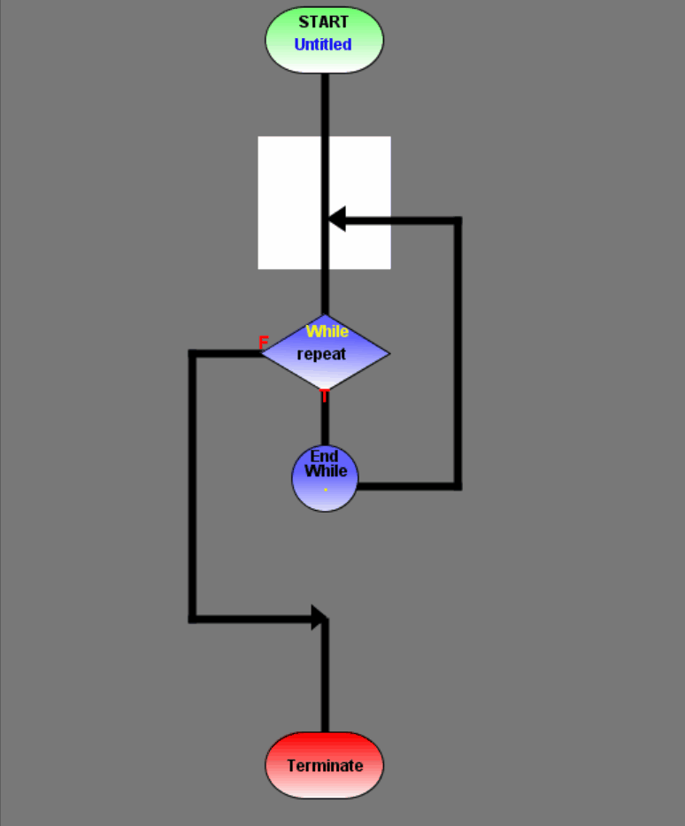

Computers are great at repeating instructions!

Slide 7
Loops
A block of instructions that will repeat based on a boolean expression.
Loop body: Code to be repeated
Control variable: Variable that will control
Exit condition: When will the block of code stop repeating?

Slide 8
While loops

Slide 9
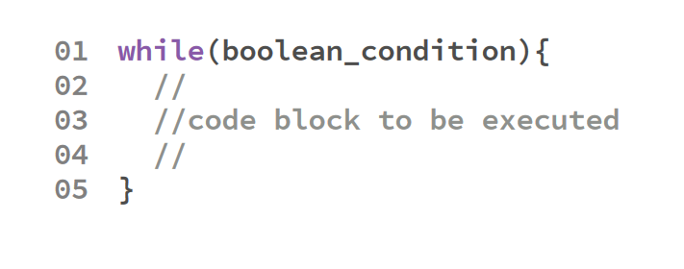
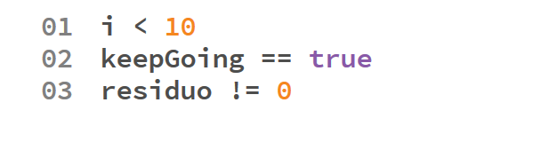
Sintaxis
Examples of boolean conditions
Conditions are boolean expressions

Slide 10
public class LoopTest {
public static void main(String[] args) {
int bits = 1;
int maxValues = 1;
while(bits <= 8) {
maxValues *= 2;
System.out.println(bits + " bit(s) -> " + maxValues + " values.");
bits++;
}
}
}

Slide 11
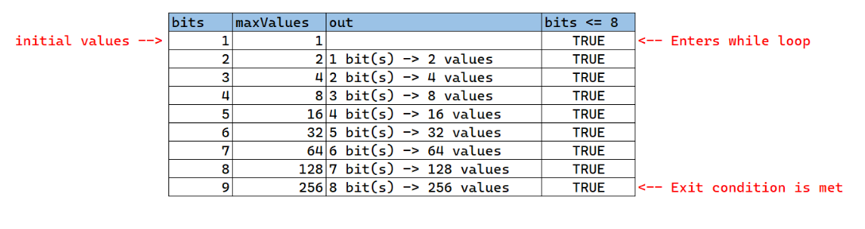
Code trace

Slide 12
Do-while

Slide 13
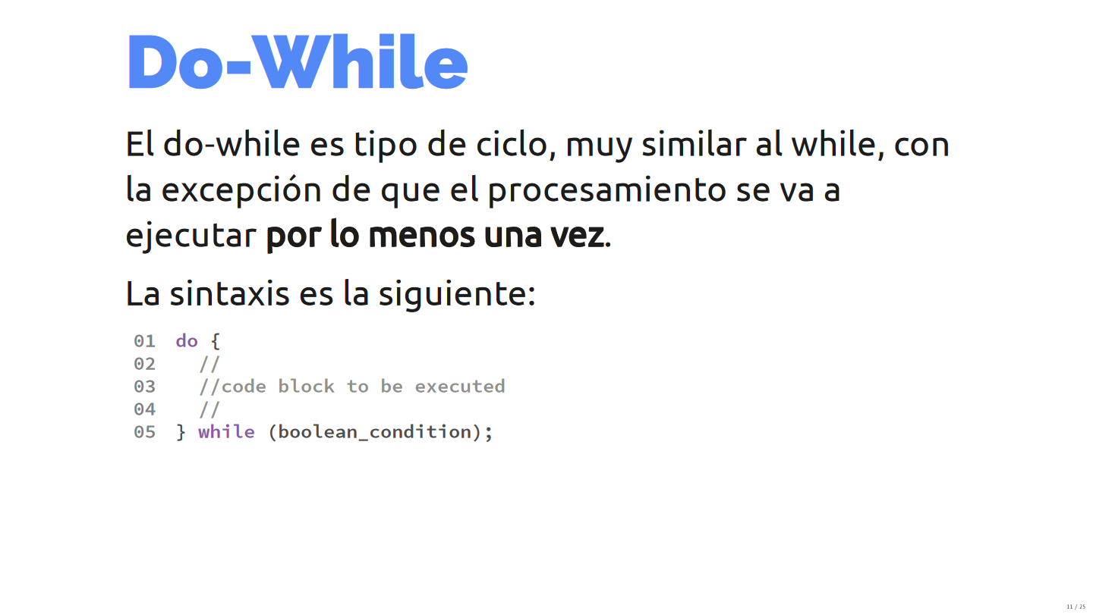

Slide 14
Do-whiles are very similar to whiles, with the exception that it will always be executed at least once.
This is because the Boolean condition is evaluated at the end of the loop, instead of at the start. This loops are very useful when validating inputs from the keyboard.

Slide 15
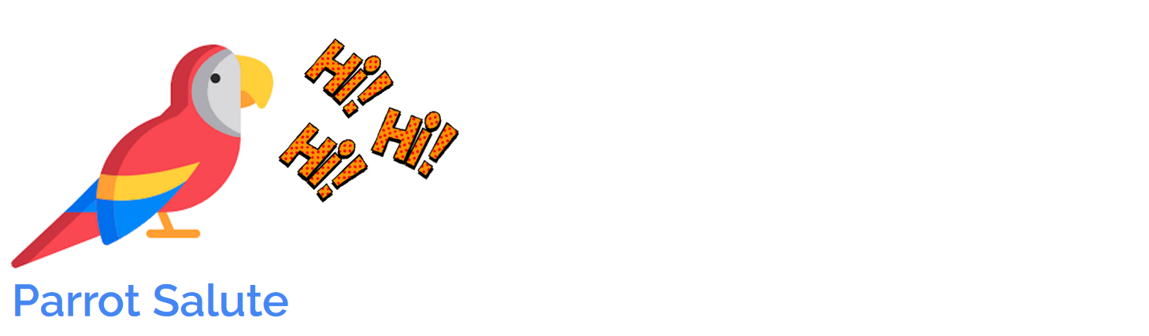
The city zoo has a very well-educated parrot that greets every group of people that passes by.
Build a program that reads the group size from the keyboard and prints the greeting to each person.
Consider that group sizes can only be between 0 and 10.

Slide 16
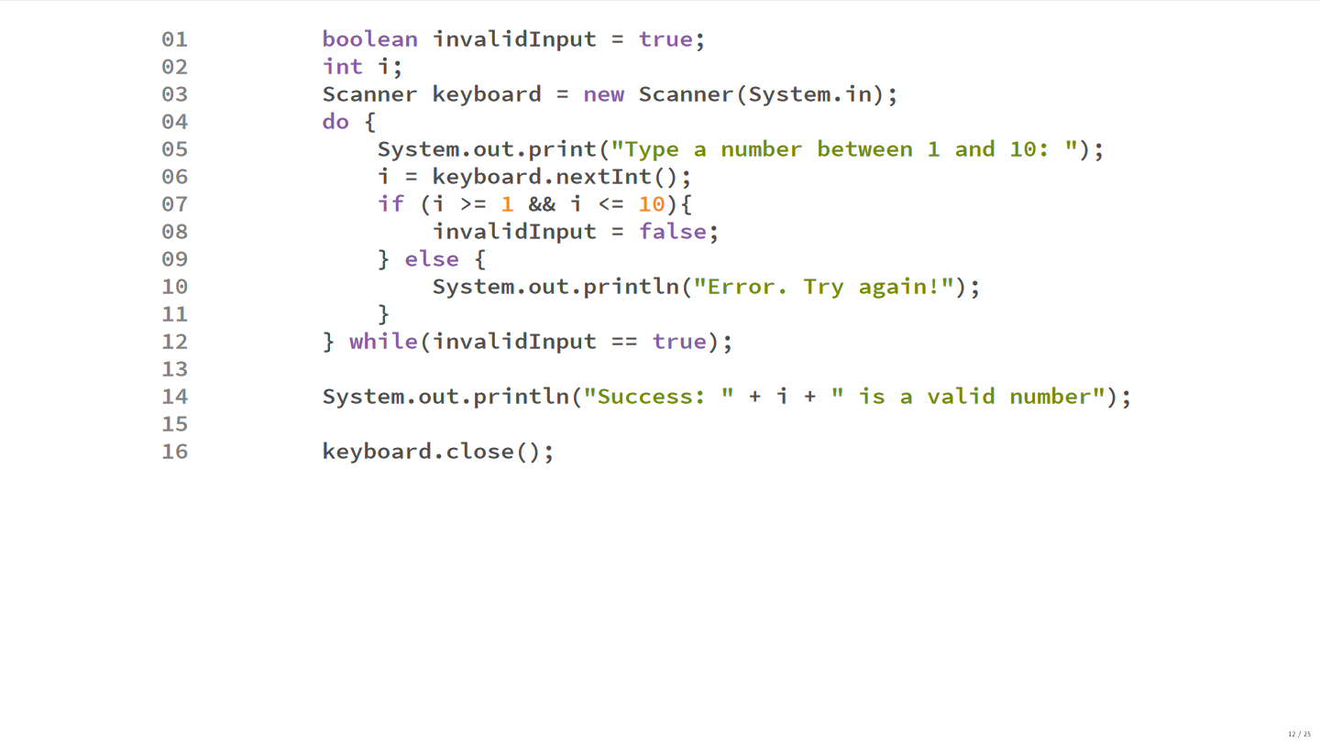

Slide 17
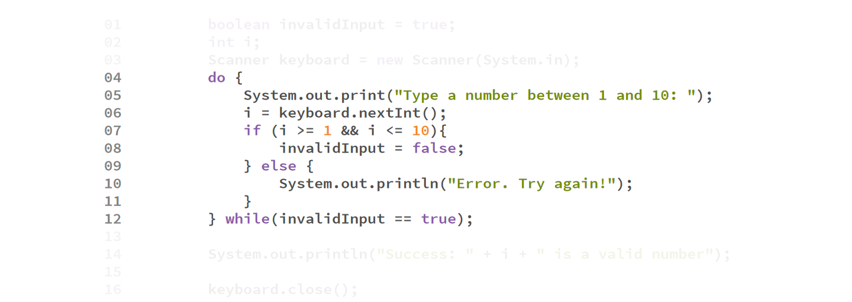

Slide 18
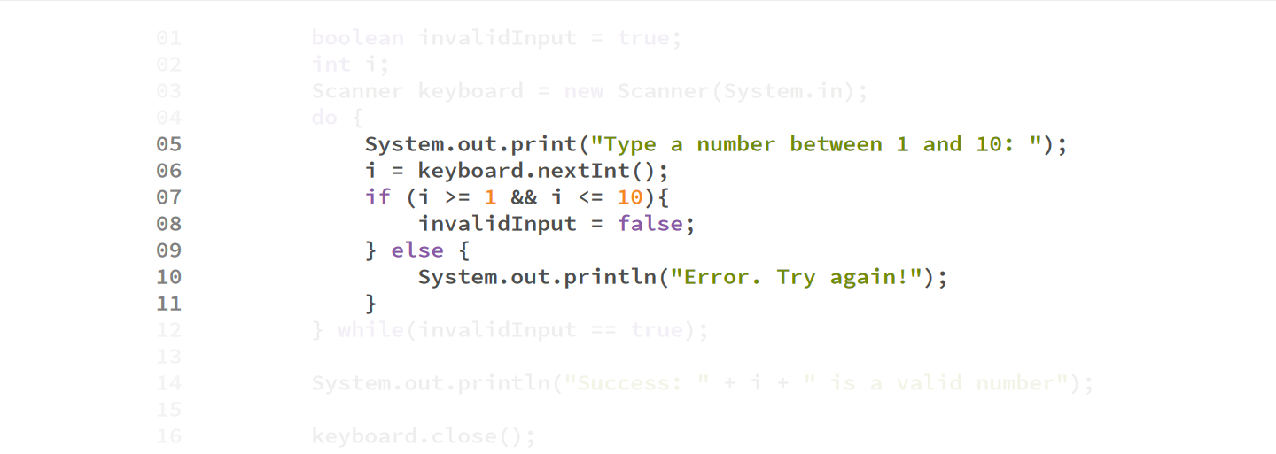

Slide 19
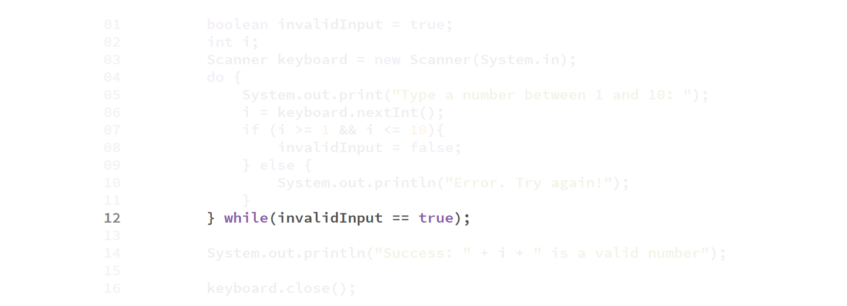

Slide 20
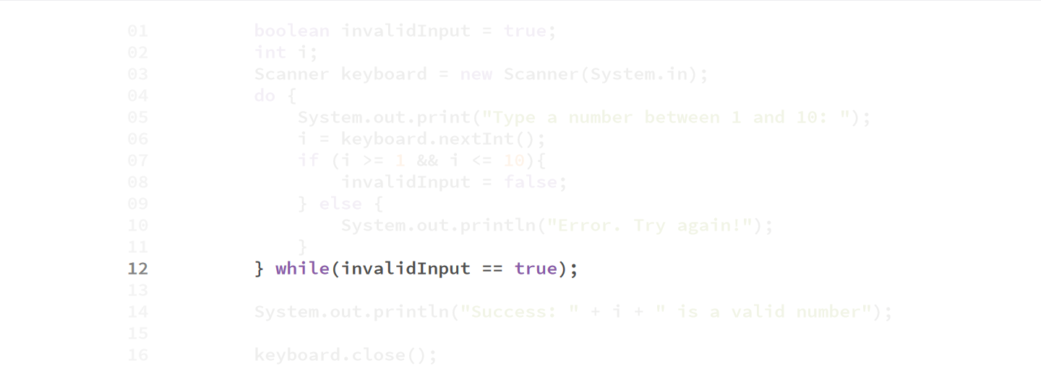

Slide 21
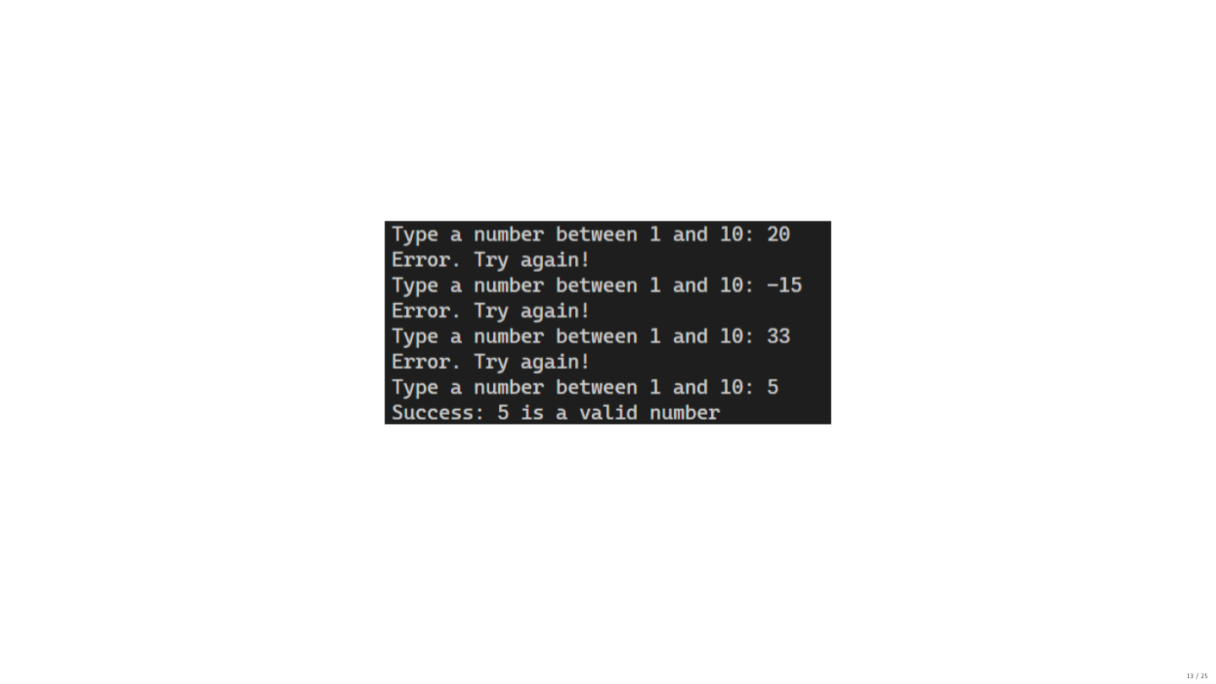

Slide 22
For loop

Slide 23
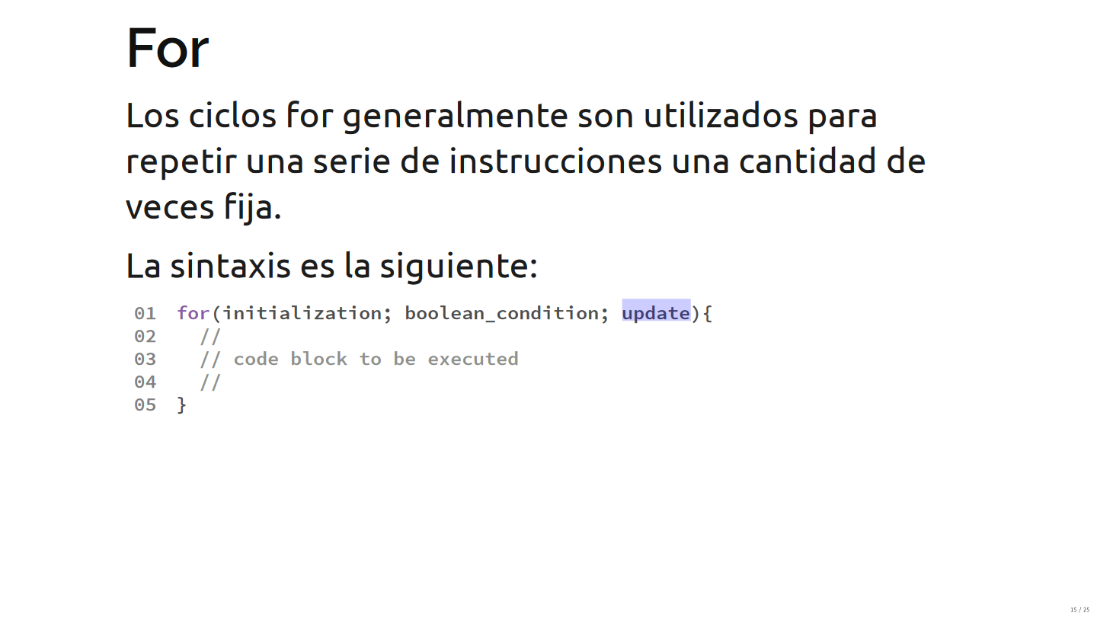

Slide 24
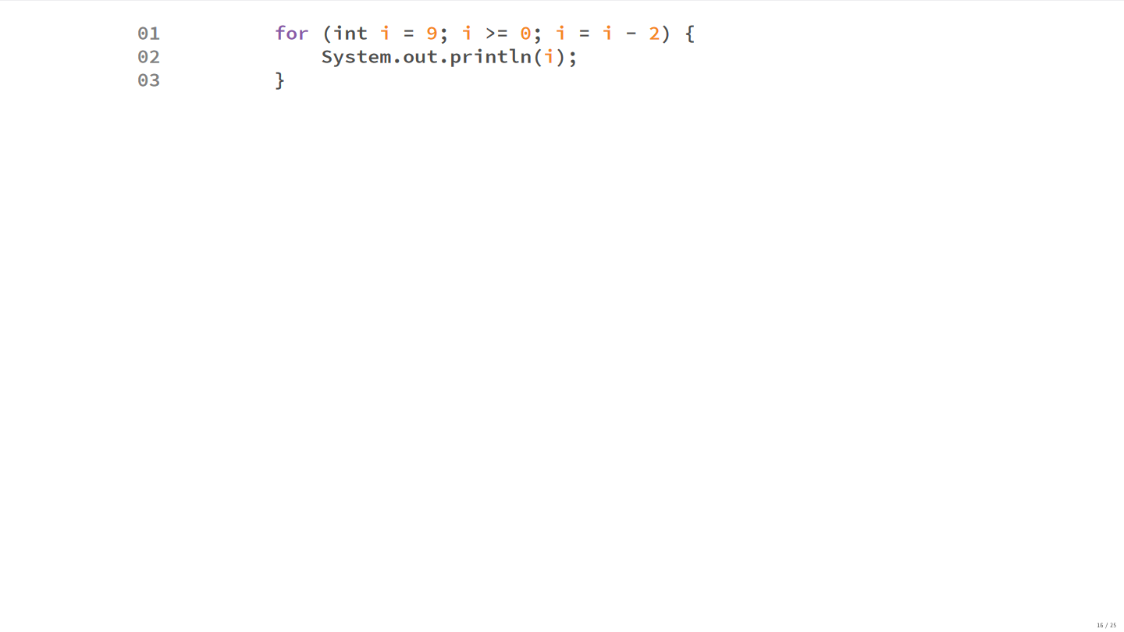

Slide 25
Example

Slide 26
The city zoo has a very well-educated parrot that greets every group of people that passes by.
Build a program that reads the group size from the keyboard and prints the greeting to each person.
Consider that group sizes can only be between 0 and 10.

Slide 27
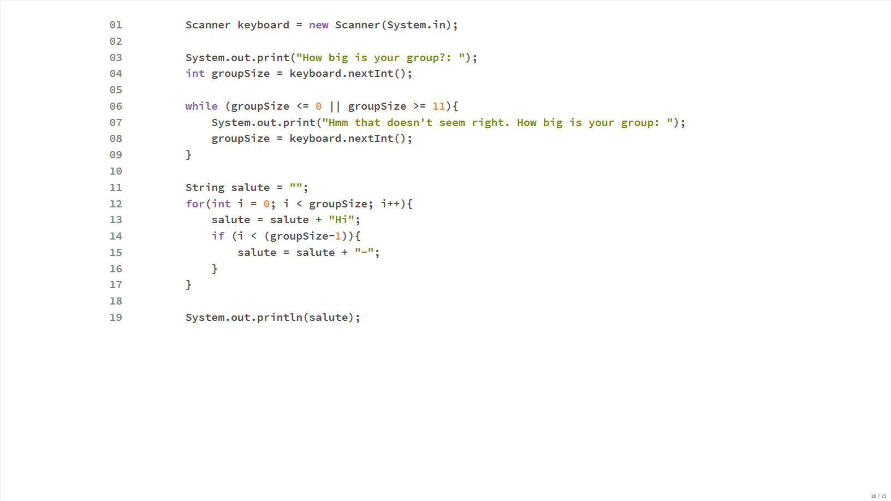

Slide 28
Common loop problems

Slide 29
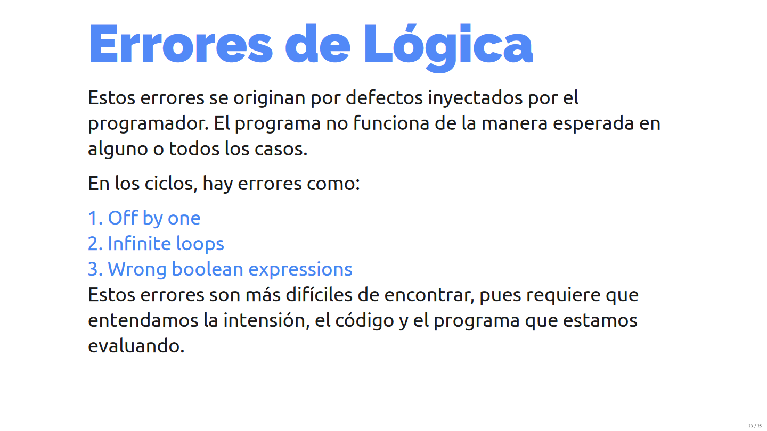

Slide 30
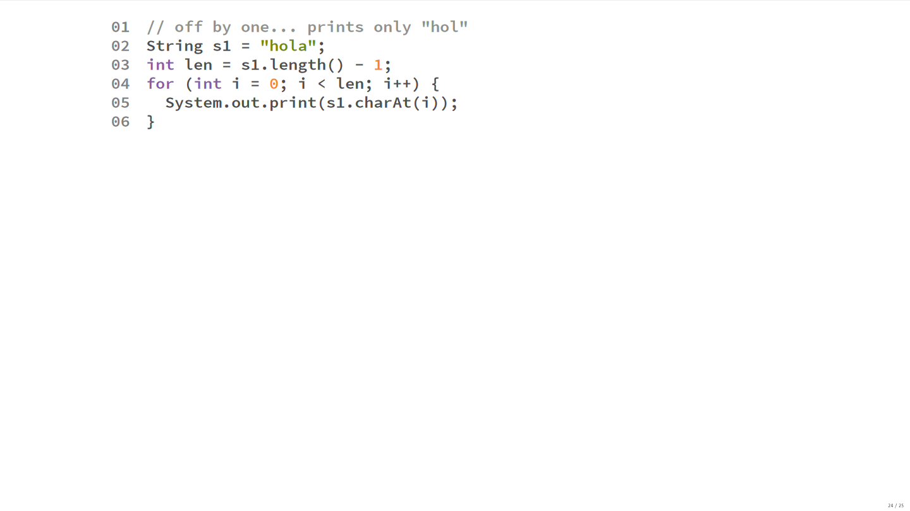

Slide 31
